Slide 1
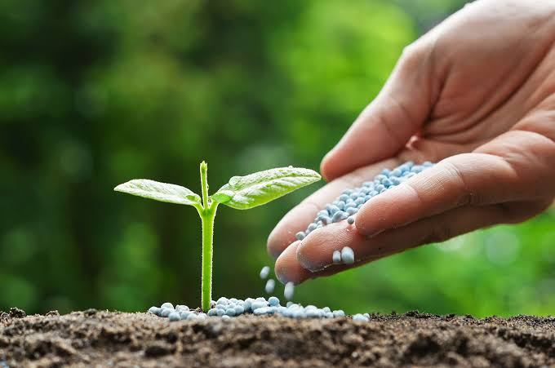
“FERTILIZERS”
Team:
QUINTET CODERS

Slide 2
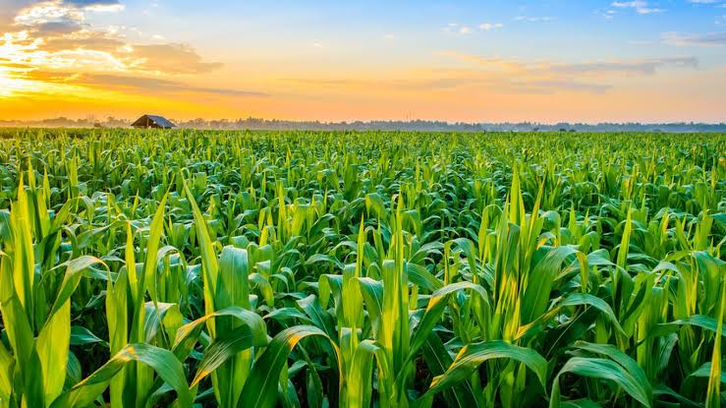
INTRODUCTION:
Indian agriculture industry is at the verge of a revolution that will modernize the entire food chain in India and as the total food production.

Slide 3
REVIEW OF LITERATURE
Objectives of research:
- The overall objective of this project is to predict the best fertilizer that can be used for a particular type of soil to help grow plants at an improved rate.

Slide 4
Problem Statement:
- Predicting the best suitable fertilizer for the effective plant growth by taking few parameters into consideration.
Temperature
Humidity
Moisture
Soil Type
Crop Type
Composition of Nitrogen, Potassium and Phosphorous.

Slide 5
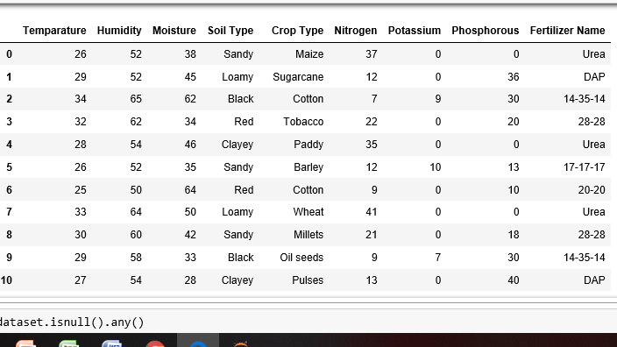
DATA COLLECTION:

Slide 6
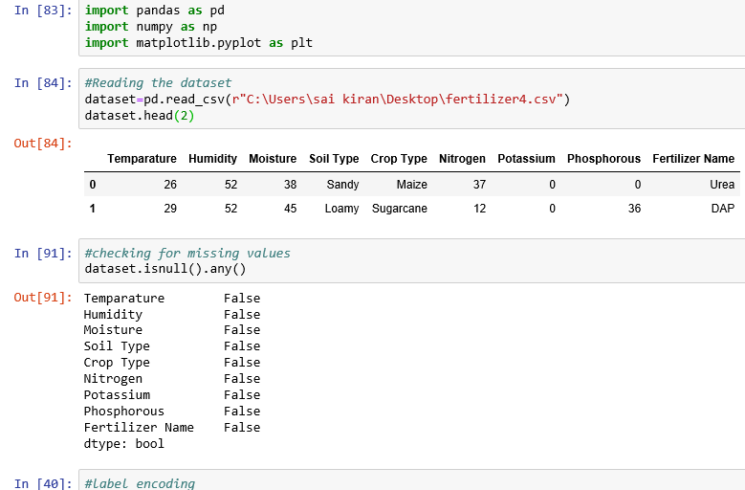
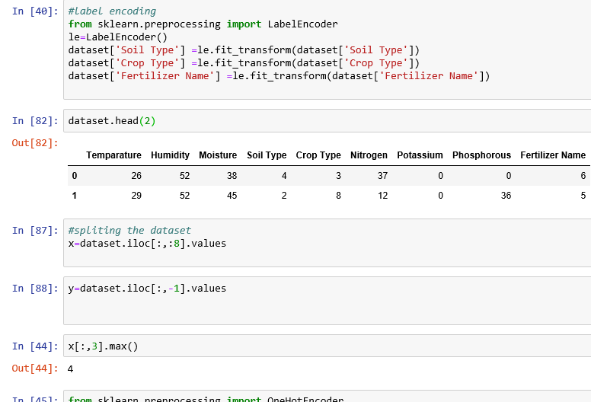
Data Preprocessing:

Slide 7
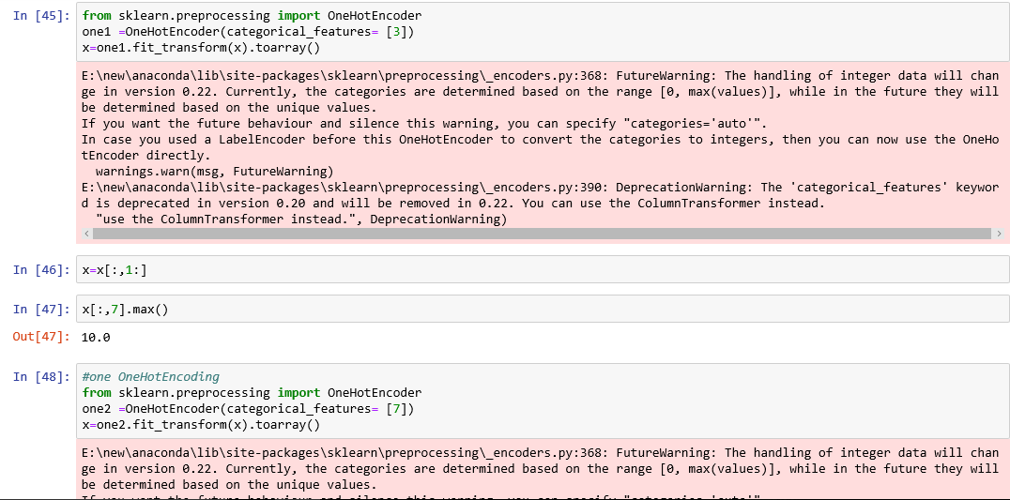
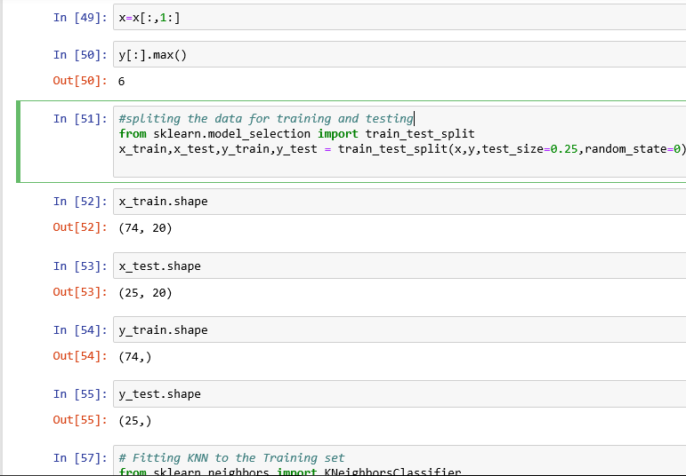

Slide 8
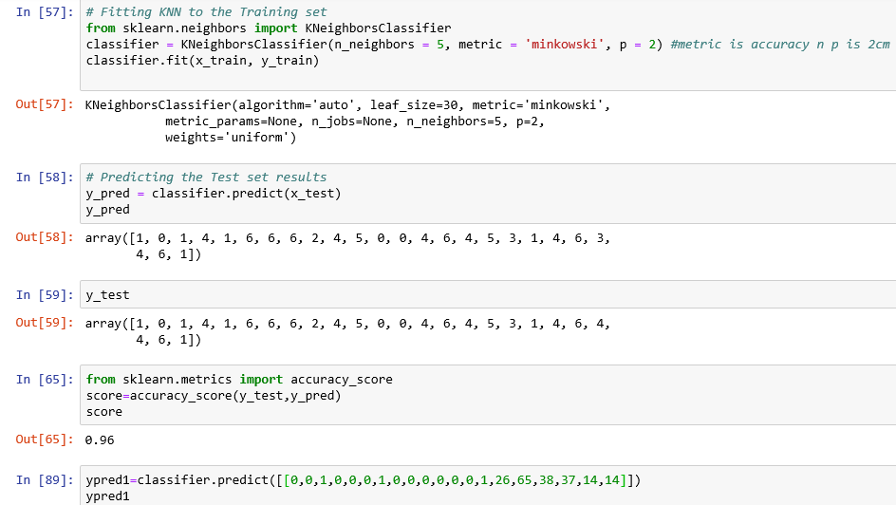
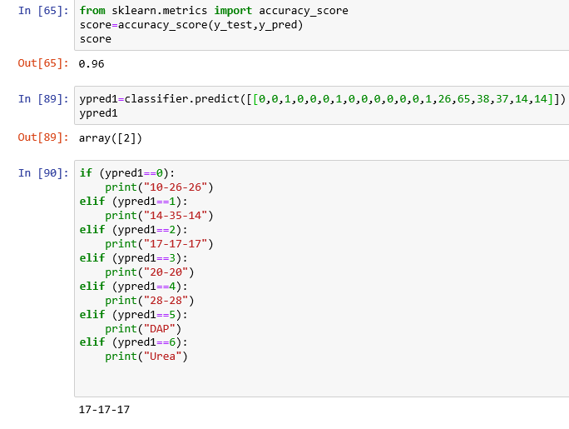

Slide 9
METHADOLOGY:
Supervised Learning
REGRESSION
Linear Regression
MultiLinear Regression
Polynmial Regression
Ridge Regression
CLASSIFCATION
1. Logistic Regression, Naive Bayes Classifier
2.Support Vector Machines
3.Decision Trees
4. Nearest Neighbor
5.Random Forest

Slide 10
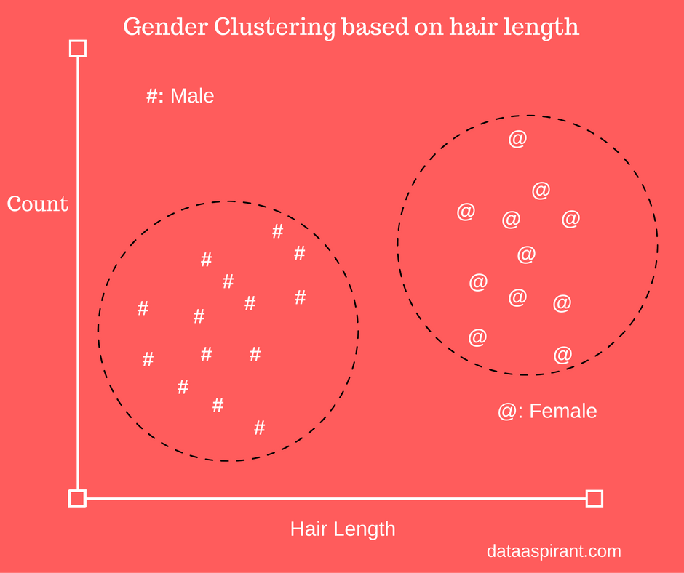
CLASSIFICATION:-
The computer program learns from the data input given to it and then uses this learning to classify new observation.
Some examples of classification problems are: speech recognition, handwriting recognition, bio metric identification, document classification etc.

Slide 11
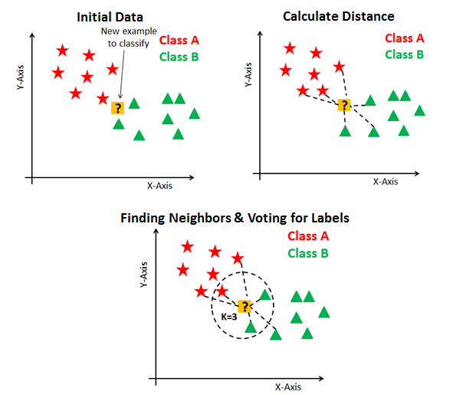
K-NEAREST NEIGHBOUR

Slide 12
ACCURACY
NAÏVE BAYES
RANDOM FOREST
92%
64%
9V2%
K-NEAREST NEIGHBOUR
96%

Slide 13
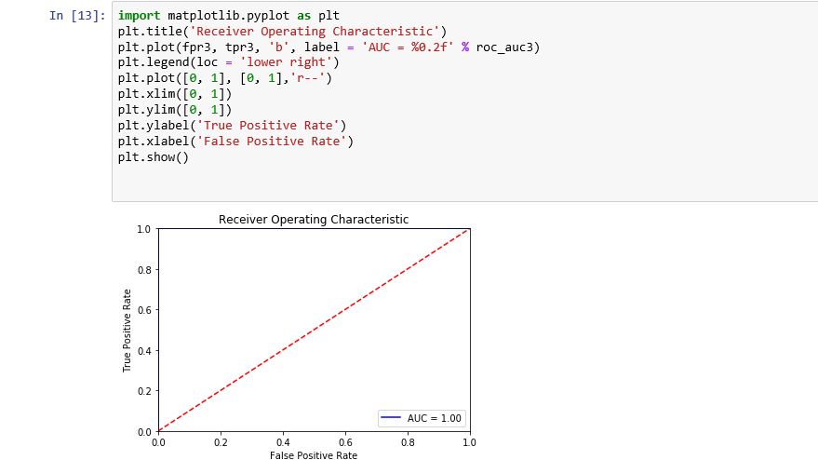
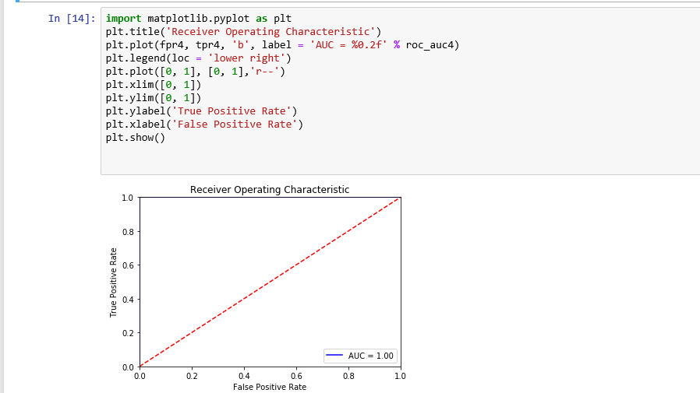

Slide 14
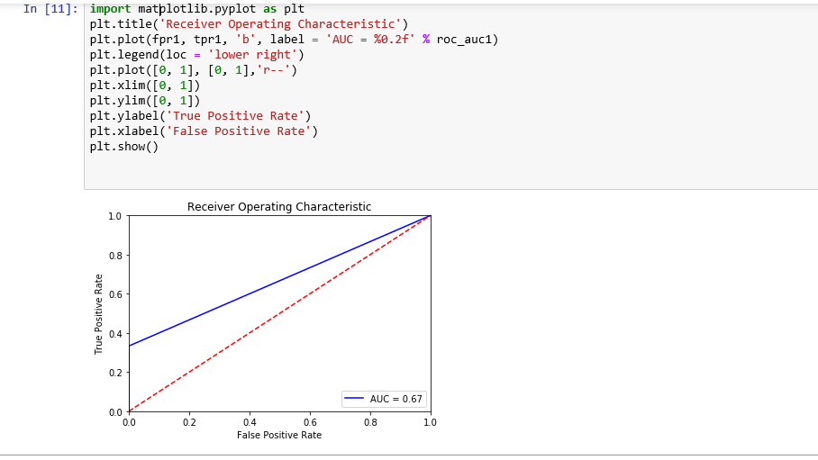
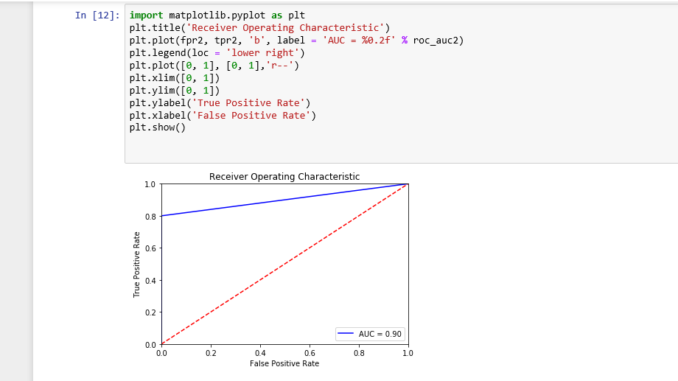

Slide 15
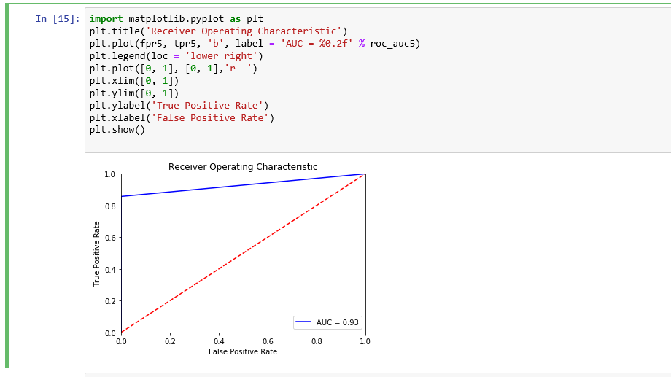
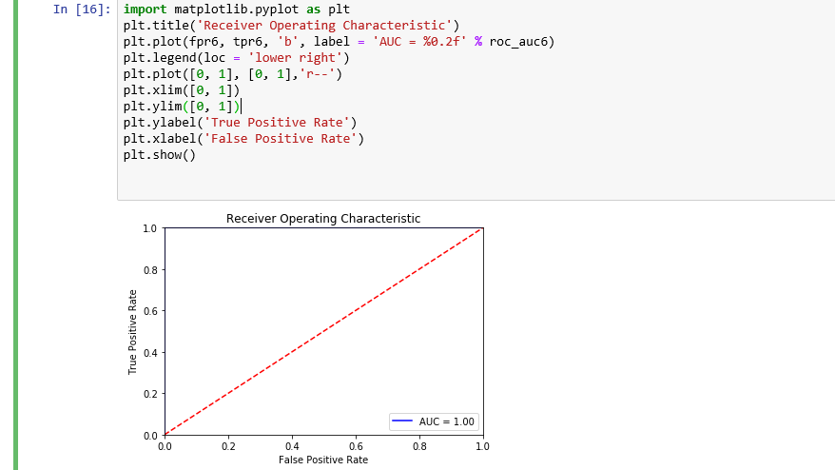

Slide 16
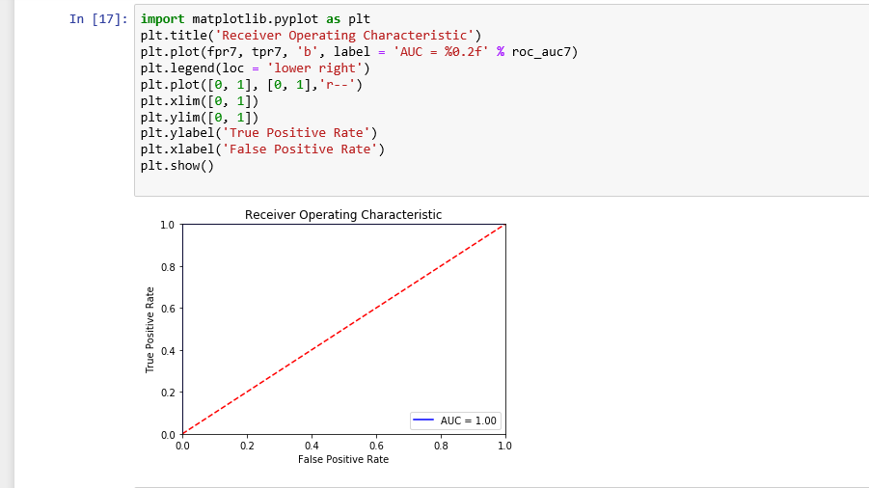

Slide 17
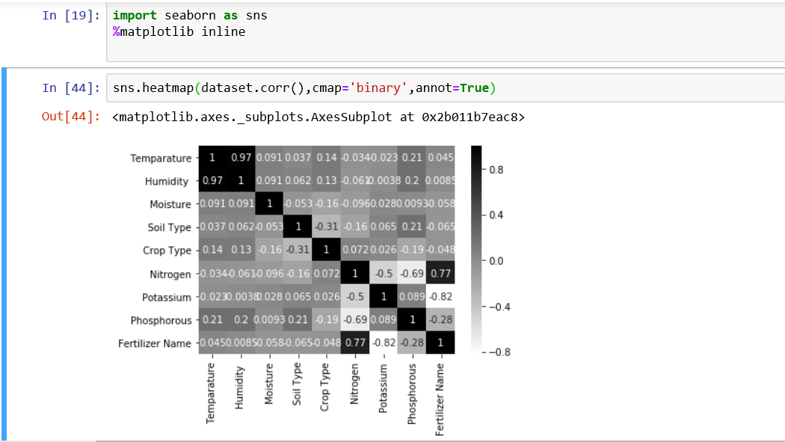
HEATMAP:

Slide 18
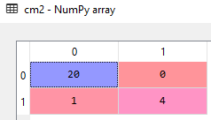
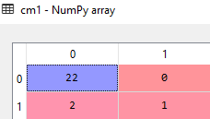
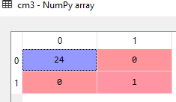
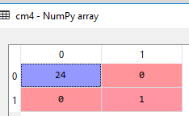
CONFUSION MATRICES:

Slide 19
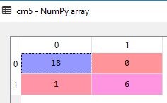
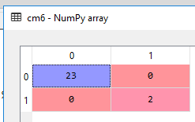
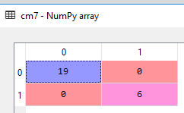

Slide 20
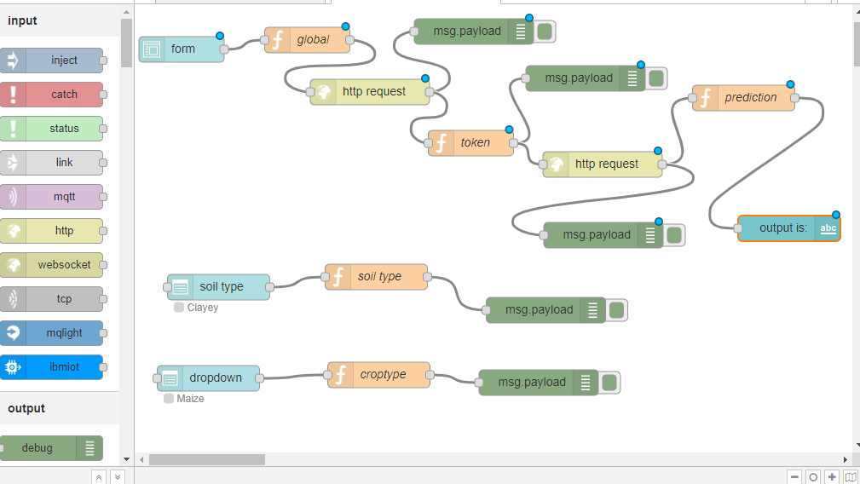
FLOW:

Slide 21
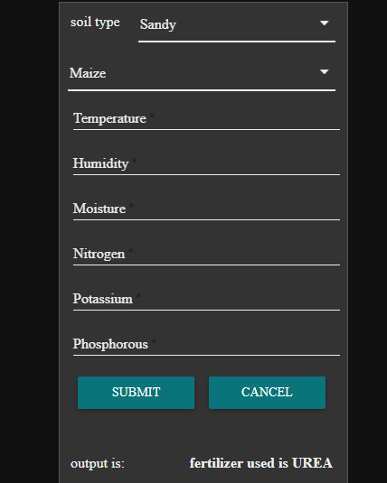
UI:

Slide 22
CONCLUSION:

